Slide 1
Make PowerPoint Presentations with R Markdown
An Introduction

Slide 2
Why would you want to create a PowerPoint presentation from R Markdown?

Slide 3

Everyone knows PowerPoint
Standard communication tool
Especially in business
People “speak” PowerPoint
Bullet points
It’s useful – it works
Flexible enough to get the job done
You can make the slides fast or pretty
Everyone has personal experience with it
Some love it
Others hate it

Slide 4

Anyone can learn R Markdown
It is so easy!
And you can use R!
Visualizations, tables, code, etc.
Plain text
Versioned, reproducible, collaborative
Emits multiple output
HTML, PDF, Microsoft Word
but not PowerPoint … UNTIL NOW!

Slide 5
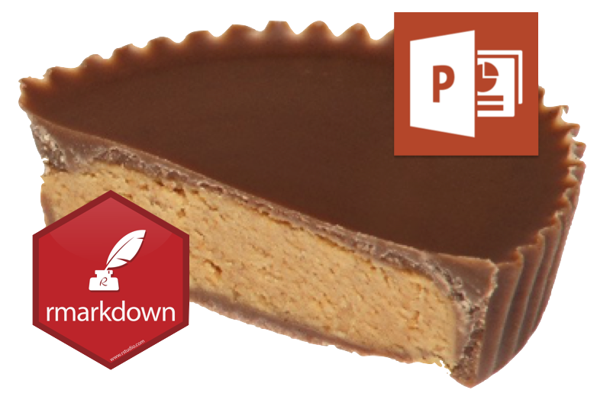
We are combining two great things
Think of it as the Rheese’s Peanut Butter Cup of presentations

Slide 6
If you don’t want to use R Markdown
You can still use popular R packages
ReportRs
OfficeR
R2PPT (windows only?)
Displayr

Slide 7
Demo: Create a PowerPoint Presentation with RStudio

Slide 8
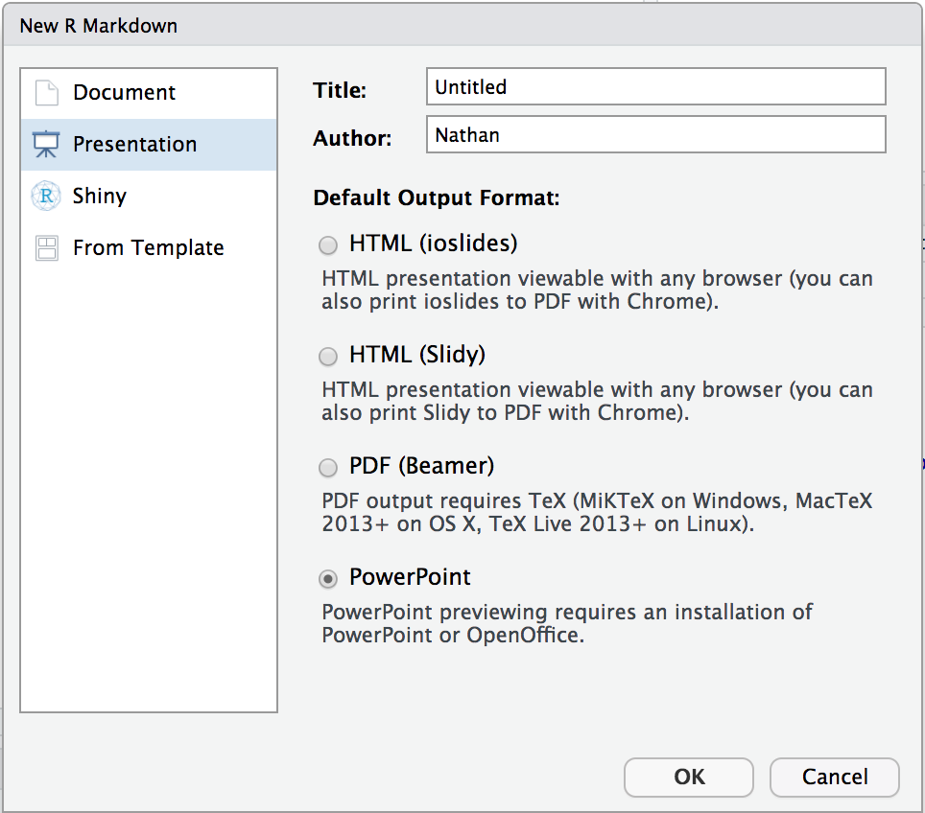
Quick Example
Create a new R Markdown Document:
File > New File > R Markdown > Presentation
Then choose:
Knit to PowerPoint
Open the presentation:
RStudio Desktop – Opens automatically
RStudio Server – Downloads automatically
You will need PowerPoint on your workstation

Slide 9
How does it work?

Slide 10

R Markdown > Markdown > Powerpoint

Slide 11

Pandoc
What is Pandoc?
Document converter (e.g. Markdown to HTML)
Free software Bundled in RStudio IDE
PowerPoint output added:
December 2017 - April 2018
Jesse Rosenthal, Johns Hopkins University
Pandoc 2.2 Features:
Markdown features
Templates
Columns
Speaker Notes
Images and Table

Slide 12
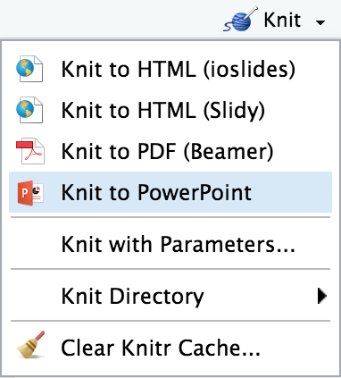
RStudio enchancements
RStudio IDE
Default template: File > New File > R Markdown
Knit to PowerPoint
Open to working slide (desktop only)
Code chunks
Includes tables and plots (e.g. ggplot)
Include webshots of HTML widgets and shiny apps
Render programmatically
IDE not required
rmarkdown::render("in.Rmd", output_format = "powerpoint_presentation")

Slide 13
Supports most markdown elements
Standard elements:
Text formats
Lists
Math expressions
Hyperlinks
And also these nifty features:
Templates
Columns
Tables and images with captions
Speaker notes

Slide 14
Supports R Code Chunks (of course!)
Control output with R code chunks and chunk options.
Verbatim output
Tables
Plots
Webshots

Slide 15
Demos

Slide 16
1. Render and customize
Output visualizations of your analysis
Output ggplot
Create webshots of shiny

Slide 17
2. Programmatically render and distribute
Example: Weekly report
Shiny app exists
Webshots and link
Publish to RStudio Connect
Send email

Slide 18
Troubleshooting

Slide 19
Common issues
Why does my PowerPoint presentation not open properly?
How do I put an image and text on the same slide?
How do I control the placement of images and text?
And other things supported and not supported
How do I structure my presentation?

Slide 20
Where to get help
Getting started link
Tutorials link
R Markdown: The Definitive Guide link
Troubleshooting link
Submitting issues link

Slide 21
End

